Slide 1

Introduction to High-Performance Parallel Distributed Computing Using Chapel
Michelle Strout
CUF23: Sponsored by OLCF, NERSC, and ECP
July 26-27, 2023

Slide 2

How to Participate in this Tutorial
See https://github.com/mstrout/ChapelForPythonProgrammersMay2023 for more info and for example code.
Poll Everywhere link: pollev.com/michellestrout402
There will be fun questions throughout the tutorial
Attempt this Online website for running Chapel code
Go to main Chapel webpage at https://chapel-lang.org/
Click on the little ATO icon on the lower left that is above the YouTube icon
Using a container on your laptop
First, install docker or podman for your machine and then start them up
Then, the below commands work with docker (see github README.md for podman)
docker pull docker.io/chapel/chapel # takes about 5 minutes
cd ChapelForPythonProgrammersMay2023 # assuming git clone has happened
docker run --rm -v "$PWD":/myapp -w /myapp chapel/chapel chpl hello.chpl
docker run --rm -v "$PWD":/myapp -w /myapp chapel/chapel ./hello
Notes:
Prerequisites: Please install podman (https://podman.io/) on your laptop beforehand or bring along a friend who has it installed on their laptop and is willing to share. Here is how you could install and start it on a mac:
brew install podman // ignore the llvm15 dep error
podman machine init
podman machine start

Slide 3
Chapel Programming Language
Chapel is a general-purpose programming language that provides
ease of parallel programming,
high performance, and
portability.
And is being used in applications in various ways:
refactoring existing codes,
developing new codes,
serving high performance to Python codes (Chapel server with Python client), and
providing distributed and shared memory parallelism for existing codes.
Notes:
providing distributed and shared memory parallelism for existing codes is for HPO, which doesn't show up later in this talk, but I am going to keep in the reference anyway

Slide 4
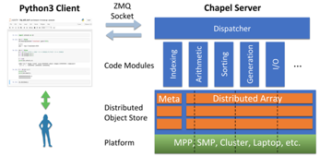
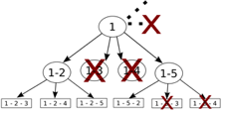
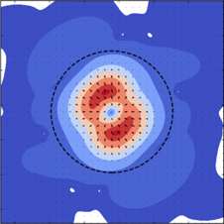
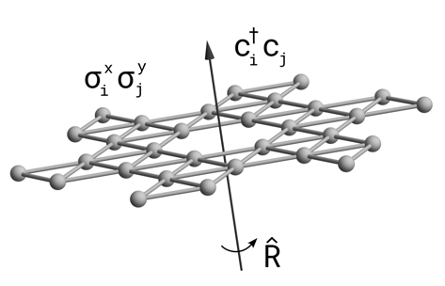
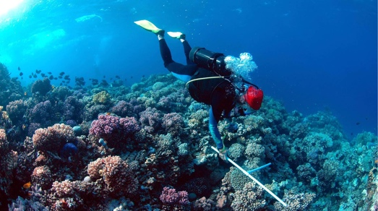

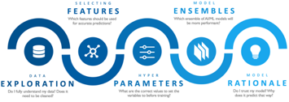
Applications of Chapel
CHAMPS: 3D Unstructured CFD
Laurendeau, Bourgault-Côté, Parenteau, Plante, et al.
École Polytechnique Montréal
Arkouda: Interactive Data Science at Massive Scale
Mike Merrill, Bill Reus, et al.
U.S. DoD
ChOp: Chapel-based Optimization
T. Carneiro, G. Helbecque, N. Melab, et al.
INRIA, IMEC, et al.
ChplUltra: Simulating Ultralight Dark Matter
Nikhil Padmanabhan, J. Luna Zagorac, et al.
Yale University et al.
Lattice-Symmetries: a Quantum Many-Body Toolbox
Tom Westerhout
Radboud University
Desk dot chpl: Utilities for Environmental Eng.
Nelson Luis Dias
The Federal University of Paraná, Brazil
RapidQ: Mapping Coral Biodiversity
Rebecca Green, Helen Fox, Scott Bachman, et al.
The Coral Reef Alliance
ChapQG: Layered Quasigeostrophic CFD
Ian Grooms and Scott Bachman
University of Colorado, Boulder et al.
?
Chapel-based Hydrological Model Calibration Marjan Asgari et al.
University of Guelph
CrayAI HyperParameter Optimization (HPO)
Ben Albrecht et al.
Cray Inc. / HPE
CHGL: Chapel Hypergraph Library
Louis Jenkins, Cliff Joslyn, Jesun Firoz, et al.
PNNL
Your Application Here?
(images provided by their respective teams and used with permission)
4
Notes:
Copied from Brad Linux Con talk in May 2023

Slide 5

Highlights of Chapel Usage
CHAMPS: Computational Fluid Dynamics framework for airplane simulation
Professor Eric Laurendeau’s team at Polytechnique Montreal
Performance: achieves competitive results w.r.t. established, world-class frameworks from Stanford, MIT, etc.
Programmability: "We ask students at the master's degree to do stuff that would take 2 years and they do it in 3 months."
Arkouda: data analytics framework (https://github.com/Bears-R-Us/arkouda)
Mike Merrill, Bill Reus, et al., US DOD
Python front end client, Chapel server that processes dozens of terabytes in seconds
April 2023: 1200 GiB/s for argsort on an HPE EX system
Recent Journal Paper on using Chapel for calibrating hydrologic models
Marjan Asgari et al, "Development of a knowledge-sharing parallel computing approach for calibrating distributed watershed hydrologic models", Environmental Modeling and Software.
They report super-linear speedup
Notes:
CHAMPS participating in 4th CFD High Lift Prediction Workshop and 1st Icing Prediction Workshop
Rest of quote: And I'm not joking, this is from 2 years to 3 months. So if you want to take a summer internship and you say 'program a new turbulance model', well they manage. And before, it was impossible to do

Slide 6
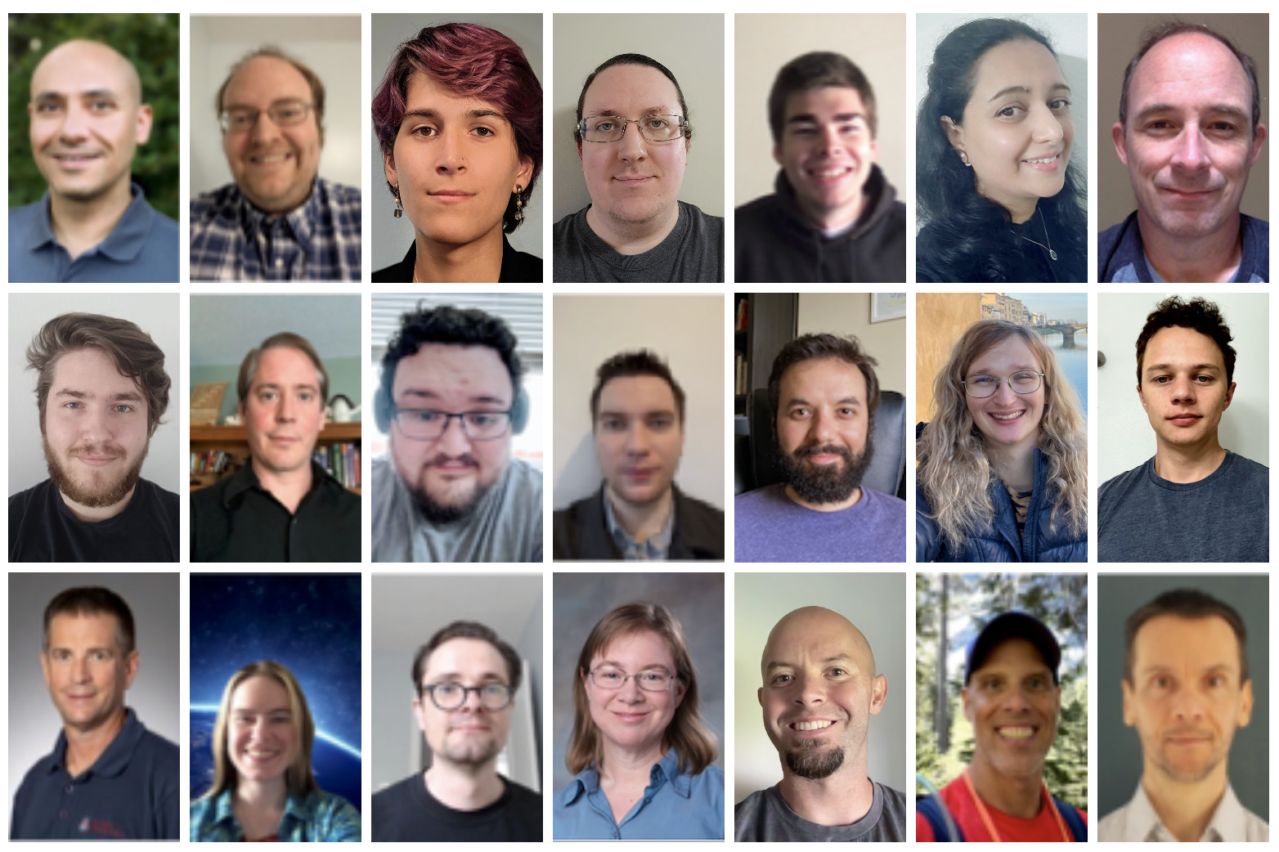
Introductions
Let’s take some time to introduce ourselves
Michelle Strout
Chapel team leader
Affiliate faculty in the Department of Computer Science at UArizona
Current Chapel team
Tech Lead: Brad Chamberlain
Visiting Scholar from NCAR: Scott Bachman
Participants, tell us some about yourself
Your institution
Proudest HPC accomplishment
Biggest HPC challenge
HPE Proprietary
Notes:
Copied from Brad’s CHIUW 2021 SOP talk. Going to update for MS17.

Slide 7
Learning Objectives For Today's Tutorial
Compile and run Chapel programs in a web browser and/or on your laptop
Familiarity with the Chapel execution model including how to run codes in parallel on a single node, across nodes, and both
Experiment compiling and running provided Chapel code examples
k-mer counting (bioinformatics application)
Processing files in parallel using parallelism over multiple nodes and threads
Solving a diffusion PDE (partial differential equation)
Image processing (coral reef diversity example)
Same code can be compiled to run on a multi-core CPU AND a GPU
Where to get help and how you can participate in the Chapel community

Slide 8
How to Participate in this Tutorial
See https://github.com/mstrout/ChapelForPythonProgrammersMay2023 for more info and for example code.
Poll Everywhere link: pollev.com/michellestrout402
There will be fun questions throughout the tutorial
Attempt this Online website for running Chapel code
Go to main Chapel webpage at https://chapel-lang.org/
Click on the little ATO icon on the lower left that is above the YouTube icon
Using a container on your laptop
First, install docker or podman for your machine and then start them up
Then, the below commands work with docker (see github README.md for podman)
docker pull docker.io/chapel/chapel # takes about 5 minutes
cd ChapelForPythonProgrammersMay2023 # assuming git clone has happened
docker run --rm -v "$PWD":/myapp -w /myapp chapel/chapel chpl hello.chpl
docker run --rm -v "$PWD":/myapp -w /myapp chapel/chapel ./hello
Try one of these options for using Chapel
Notes:
Prerequisites: Please install podman (https://podman.io/) on your laptop beforehand or bring along a friend who has it installed on their laptop and is willing to share. Here is how you could install and start it on a mac:
brew install podman // ignore the llvm15 dep error
podman machine init
podman machine start

Slide 9
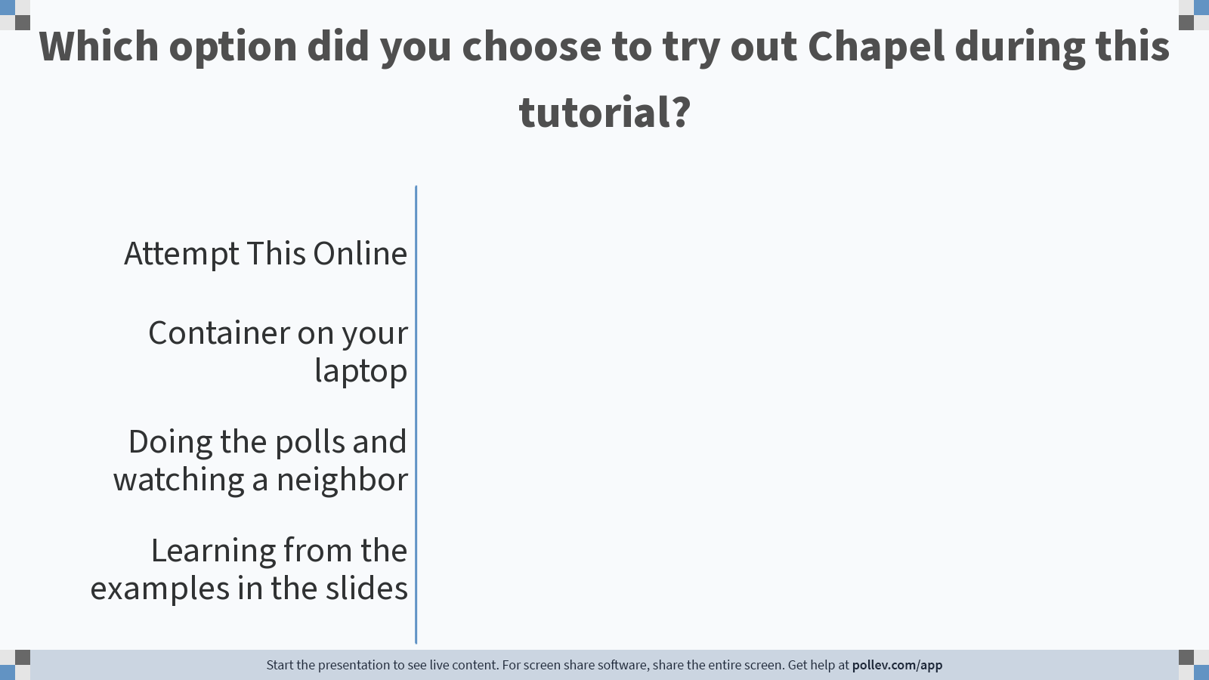
Notes:
Do not modify the notes in this section to avoid tampering with the Poll Everywhere activity. More info at polleverywhere.com/support Which option did you choose to try out Chapel during this tutorial?
https://www.polleverywhere.com/multiple_choice_polls/svUqlWB13QfcdkHhRM3Us

Slide 10
Parallelism Across Nodes and Within Nodes
// can be set on the command line with --tasksPerLocale=2
config const tasksPerLocale = 1;
// parallel loops over nodes and then over threads
coforall loc in Locales do on loc {
coforall tid in 0..#tasksPerLocale {
writeln("Hello world! ",
"(from task ", tid,
" of ", tasksPerLocale,
" on locale ", here.id,
" of ", numLocales, ")" );
}
}
Parallel hello world
ExamplesInSlides/hellopar.chpl
Key concepts
'coforall'
configuration constants, 'config const'
range values, '0..#tasksPerLocale'
'writeln'
inline comments start with '//'

Slide 11
Chapel Execution Model and Terminology: Locales
Locales can run tasks and store variables
Think “compute node” on a parallel system
User specifies number of locales on executable’s command-line
prompt> ./myChapelProgram --numLocales=4 # or ‘–nl 4’
locale 0
locale 1
locale 2
locale 3
Locales array:
User’s code starts running as a single task on locale 0

Slide 12
Task-Parallel “Hello world”
helloTaskPar.chpl
const numTasks = here.numPUs();
coforall tid in 1..numTasks do
writef("Hello from task %n of %n on %s\n",
tid, numTasks, here.name);
Notes:
FIXME: change to writeln

Slide 13
Task-Parallel “Hello world”
helloTaskPar.chpl
‘here’ refers to the locale on which we’re currently running
const numTasks = here.numPUs();
coforall tid in 1..numTasks do
writef("Hello from task %n of %n on %s\n",
tid, numTasks, here.name);
how many processing units (think “cores”) does my locale have?
what’s my locale’s name?
Notes:
FIXME: change to writeln

Slide 14
Task-Parallel “Hello world”
helloTaskPar.chpl
const numTasks = here.numPUs();
coforall tid in 1..numTasks do
writef("Hello from task %n of %n on %s\n",
tid, numTasks, here.name);
a 'coforall’ loop executes each iteration as an independent task
prompt> chpl helloTaskPar.chpl
prompt> ./helloTaskPar
Hello from task 1 of 4 on n1032
Hello from task 4 of 4 on n1032
Hello from task 3 of 4 on n1032
Hello from task 2 of 4 on n1032
Notes:
FIXME: change to writeln

Slide 15
Task-Parallel “Hello world”
helloTaskPar.chpl
const numTasks = here.numPUs();
coforall tid in 1..numTasks do
writef("Hello from task %n of %n on %s\n",
tid, numTasks, here.name);
prompt> chpl helloTaskPar.chpl
prompt> ./helloTaskPar
Hello from task 1 of 4 on n1032
Hello from task 4 of 4 on n1032
Hello from task 3 of 4 on n1032
Hello from task 2 of 4 on n1032
So far, this is a shared-memory program
Nothing refers to remote locales, explicitly or implicitly
Notes:
FIXME: change to writeln

Slide 16
Task-Parallel “Hello world” (Distributed version)
helloTaskPar.chpl
coforall loc in Locales {
on loc {
const numTasks = here.numPUs();
coforall tid in 1..numTasks do
writef("Hello from task %n of %n on %s\n",
tid, numTasks, here.name);
}
}
Notes:
FIXME: change to writeln

Slide 17
Task-Parallel “Hello world” (Distributed version)
helloTaskPar.chpl
create a task per locale on which the program is running
coforall loc in Locales {
on loc {
const numTasks = here.numPUs();
coforall tid in 1..numTasks do
writef("Hello from task %n of %n on %s\n",
tid, numTasks, here.name);
}
}
have each task run ‘on’ its locale
then print a message per core, as before
prompt> chpl helloTaskPar.chpl
prompt> ./helloTaskPar -nl=4
Hello from task 1 of 4 on n1032
Hello from task 4 of 4 on n1032
Hello from task 1 of 4 on n1034
Hello from task 2 of 4 on n1032
Hello from task 1 of 4 on n1033
Hello from task 3 of 4 on n1034
Hello from task 1 of 4 on n1035
…
Notes:
FIXME: change to writeln

Slide 18
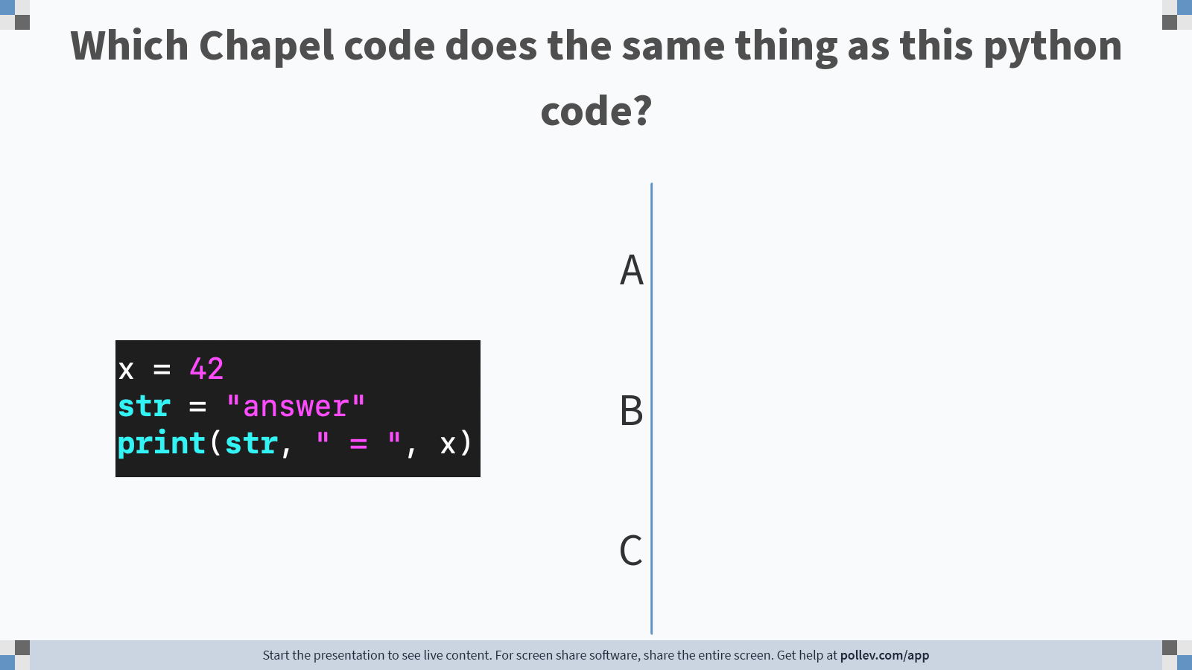
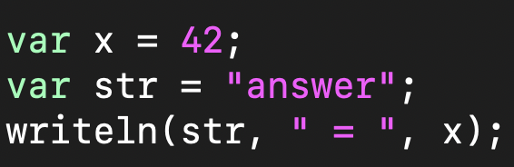
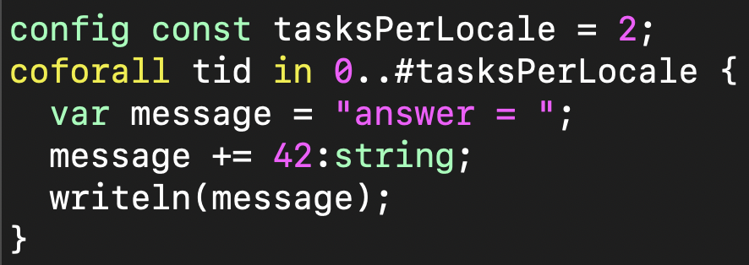
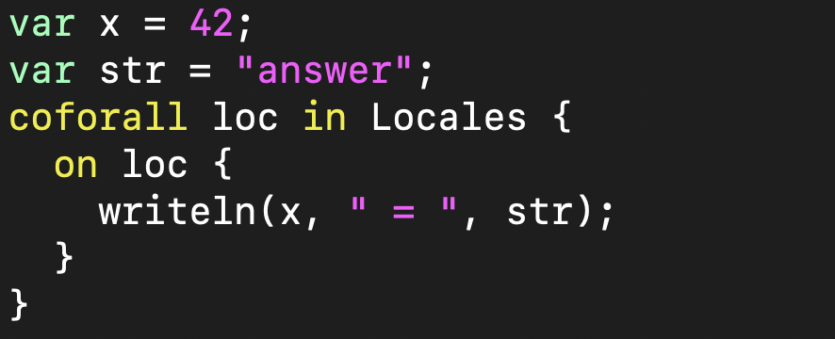
A
B
C
Notes:
Do not modify the notes in this section to avoid tampering with the Poll Everywhere activity. More info at polleverywhere.com/support Which Chapel code does the same thing as this python code?
https://www.polleverywhere.com/multiple_choice_polls/QJTmSdtZ2nCLezlK4hDeX?state=opened&flow=Default&onscreen=persist

Slide 19
K-mer Counting from Bioinformatics
kmer.chpl
‘Map’ and 'IO' are two of the standard libraries provided in Chapel. A 'map' is like a dictionary in python.
use Map, IO;
config const infilename = ("kmer_large_input.txt");
config const k = 4;
var sequence, line : string;
var f = open(infilename, ioMode.r);
var infile = f.reader();
while infile.readLine(line) {
sequence += line.strip();
}
infile.close();
var nkmerCounts : map(string, int);
for ind in 0..<(sequence.size-k) {
nkmerCounts[sequence[ind..#k]] += 1;
}
'config const' indicates a configuration constant, which result in built-in command-line parsing
Reading all of the lines from the input file into the string 'sequence'.
The variable 'nkmerCounts' is being declared as a dictionary mapping strings to ints
Counting up each kmer in the sequence
Notes:
Talk about the code and have them run it.

Slide 20
Experimenting with the k-mer Example
See https://github.com/mstrout/ChapelForPythonProgrammersMay2023 for more info and for example code.
Some things to try out with 'ExamplesInSlides/kmer.chpl'
chpl kmer.chpl
./kmer
./kmer –-k=10 # can change k
./kmer --infilename="kmer.chpl" # can change the infilename
./kmer --k=10 --infilename="kmer.chpl" # can change both
Notes:
FIXME: Does ATO work with the kmer example? Could show them copying and pasting from github into ATO?
Prerequisites: Please install podman (https://podman.io/) on your laptop beforehand or bring along a friend who has it installed on their laptop and is willing to share. Here is how you could install and start it on a mac:
brew install podman // ignore the llvm15 dep error
podman machine init
podman machine start

Slide 21
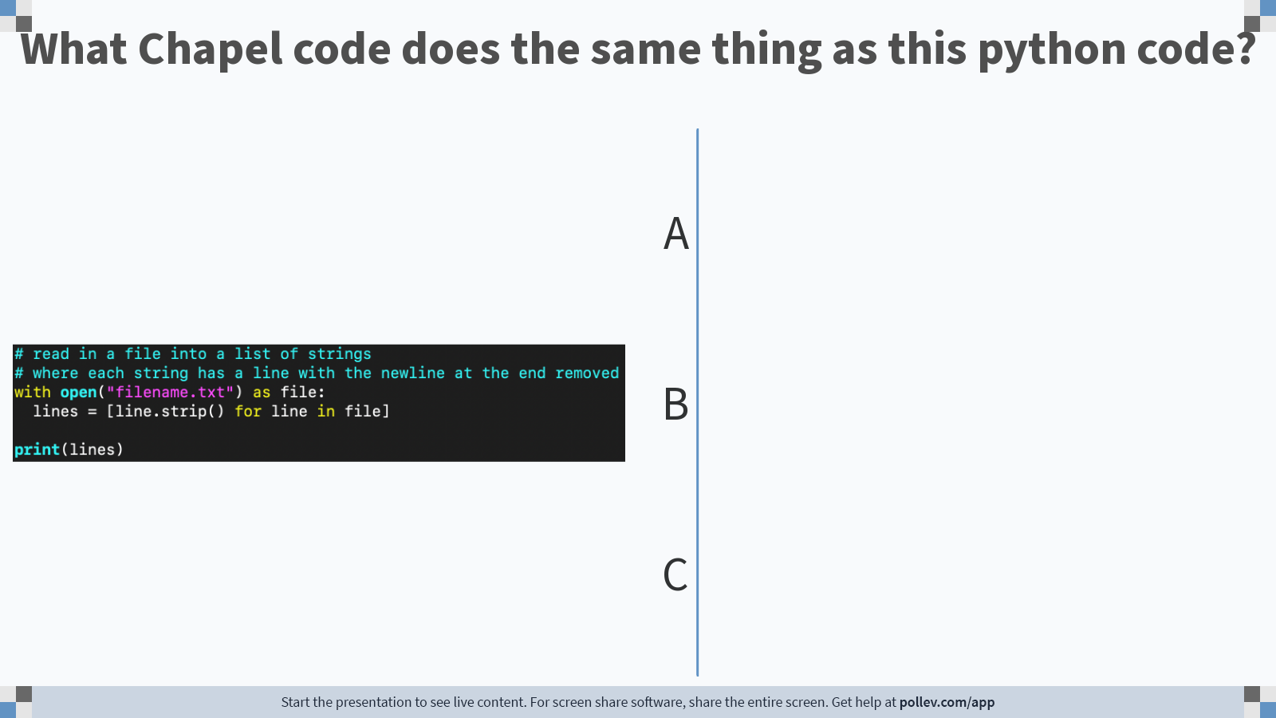
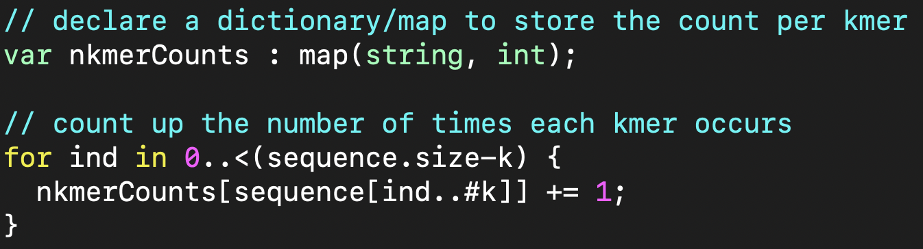
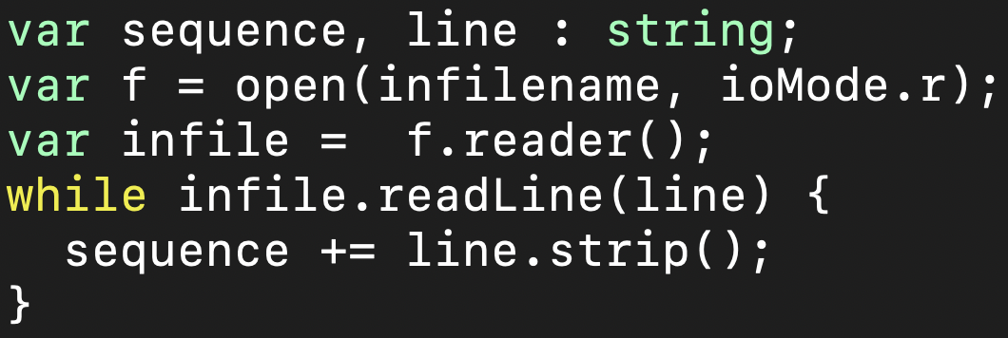
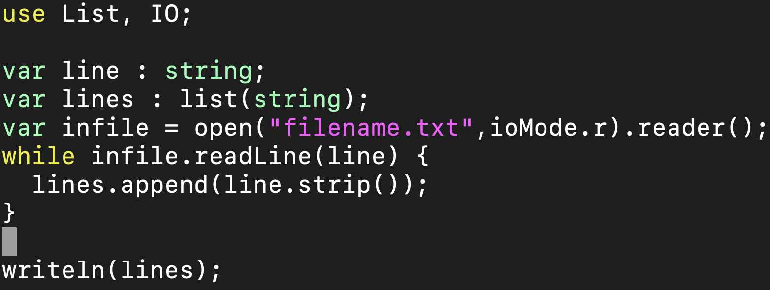
A
B
C
Notes:
Do not modify the notes in this section to avoid tampering with the Poll Everywhere activity. More info at polleverywhere.com/support What Chapel code does the same thing as this python code?
https://www.polleverywhere.com/multiple_choice_polls/3bYH8nG7Y8dzjiNO1ubEx?state=opened&flow=Default&onscreen=persist

Slide 22
2D Diffusion Partial Differential Equation Example
See https://github.com/mstrout/ChapelForPythonProgrammersMay2023 for more info and for example code.
See 'ExamplesInSlides/diffusion.chpl' in the repository
Some things to try out with 'diffusion.chpl'
chpl diffusion.chpl
./diffusion
--xLen=4 --yLen=4 --nx=61 --ny=61 # doubles the size of the domain
# along each dimension, keeping the
# density of points the same
--nu=0.025 # reduces the fluid viscosity
--nt=100 # twice as many timesteps

Slide 23
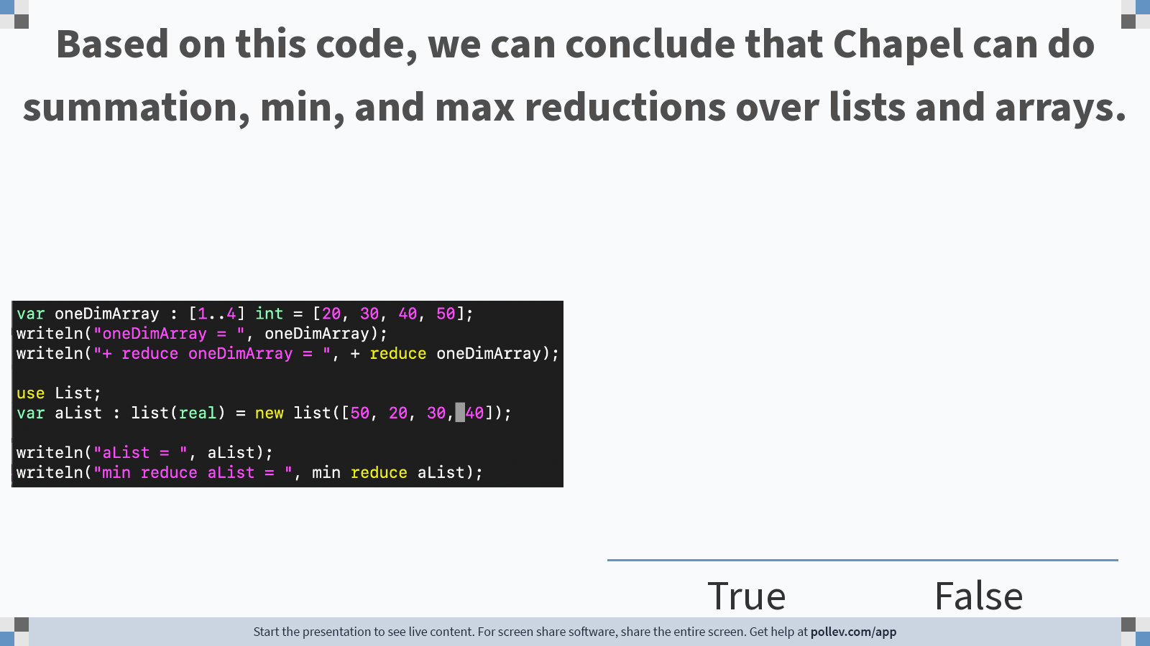
Notes:
Do not modify the notes in this section to avoid tampering with the Poll Everywhere activity. More info at polleverywhere.com/support Based on this code, we can conclude that Chapel can do summation, min, and max reductions over lists and arrays.
https://www.polleverywhere.com/multiple_choice_polls/sP2IVEQEAabAXvGwxH6Lw

Slide 24
Writing Out Everything Example
See https://github.com/mstrout/ChapelForPythonProgrammersMay2023 for more info and for example code.
See 'ExamplesInSlides/writelnExamples.chpl' in the repository
Key points
The Chapel compiler provides default 'writeThis' routines for every standard library and user-defined datatype
This helps enable "printf" debugging through the use of 'writeln' calls

Slide 25
Analyzing Multiple Files Using PArallelism
parfilekmer.chpl
prompt> chpl --fast parfilekmer.chpl
prompt> ./parfilekmer
prompt> ./parfilekmer –nl 4
use FileSystem;
config const dir = “DataDir”;
var fList = findFiles(dir);
var filenames =
Block.createArray(0..#fList.size,string);
filenames = fList;
// per file word count
forall f in filenames {
...
// code from kmer.chpl
...
}
Shared and Distributed-Memory Parallelism using forall, a distributed array, and command line options to indicate number of locales

Slide 26
Processing Files in Parallel
See https://github.com/mstrout/ChapelForPythonProgrammersMay2023 for more info and for example code.
See 'ExamplesInSlides/parfilekmer.chpl' in the repository
Some things to try out with 'parfilekmer.chpl'
# put more and bigger files into DataDir/
# or set the config const dir to something else
chpl parfilekmer.chpl
./parfilekmer --dir="SomethingElse/"
./parfilekmer –-k=10 # can also change k

Slide 27
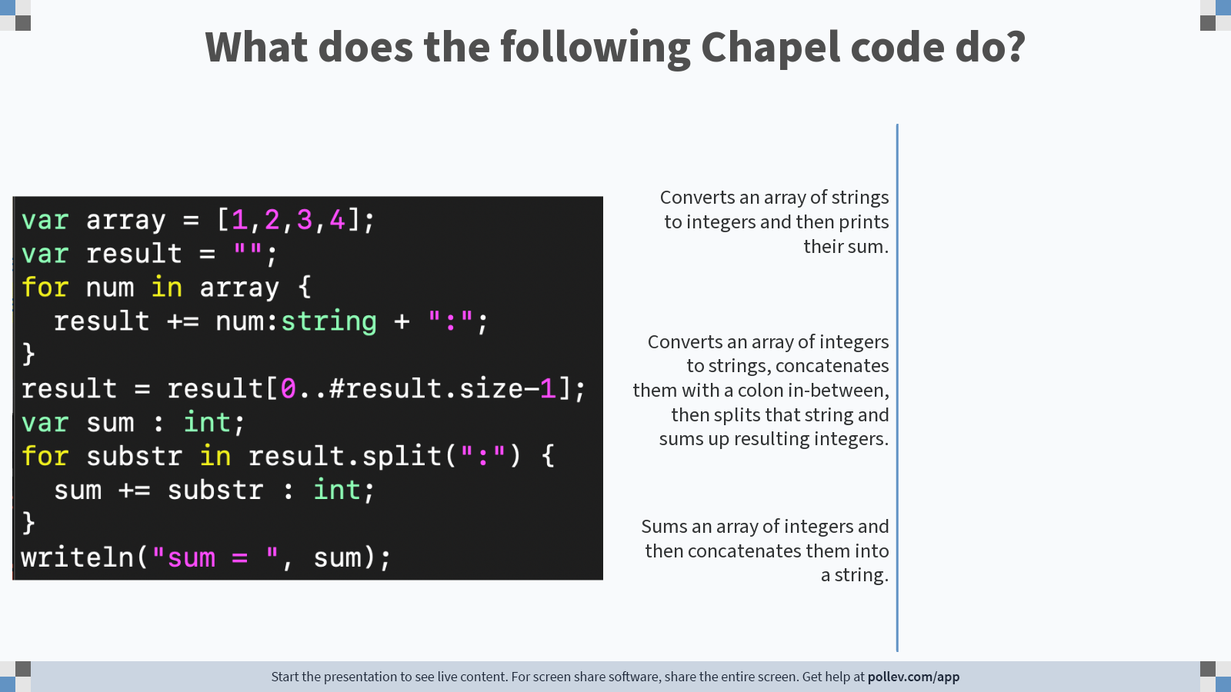
Notes:
Do not modify the notes in this section to avoid tampering with the Poll Everywhere activity. More info at polleverywhere.com/support What does the following Chapel code do?
https://www.polleverywhere.com/multiple_choice_polls/ehk8pcDciUhQy0KVOKKv6

Slide 28
Image Processing Example
See https://github.com/mstrout/ChapelForPythonProgrammersMay2023 for more info and for example code.
See 'image_analysis_example/' subdirectory in the repository
Coral reef diversity analysis written by Scott Bachman
Calls out to libpng to read and write PNG files
Uses distributed and shared memory parallelism
'image_analysis_example/README.md' explains how to compile and run it
Some things to try out when running 'main'
./main -nl 4 --inname=Roatan_benthic_r3_gray.png --outname=out1.png --radius=10
./main -nl 4 --inname=Roatan_benthic_r3_gray.png --outname=out2.png --radius=100
# Can also change the number of locales, but only up to the -N number given to salloc

Slide 29
GPU Support in Chapel
Generate code for GPUs
Support for NVIDIA and AMD GPUs
Exploring Intel support
Chapel code calling CUDA examples
https://github.com/chapel-lang/chapel/blob/main/test/gpu/interop/stream/streamChpl.chpl
https://github.com/chapel-lang/chapel/blob/main/test/gpu/interop/cuBLAS/cuBLAS.chpl
Key concepts
Using the 'locale' concept to indicate execution and data allocation on GPUs
'forall' and 'foreach' loops will be converted to kernels
Arrays declared in 'on here.gpus[i]' blocks are allocated on the GPU
For more info...
https://chapel-lang.org/docs/technotes/gpu.html
use GpuDiagnostics;
startGpuDiagnostics();
var operateOn =
if here.gpus.size>0 then here.gpus
else [here,];
// Same code can run on GPU or CPU
coforall loc in operateOn do on loc {
var A : [1..10] int;
foreach a in A do a+=1;
writeln(A);
}
stopGpuDiagnostics();
writeln(getGpuDiagnostics());

Slide 30
Stream Triad: Shared Memory
stream-ep.chpl
config var n = 1_000_000,
alpha = 0.01;
var A, B, C: [1..n] real;
A = B + alpha * C;
Declare three arrays of size ‘n’
Whole-array operations compute Stream Triad in parallel
So far, this is simply a multi-core program
Nothing refers to remote locales (nodes), explicitly or implicitly
Notes:
Copied these slides from the PNW PLSE talk Brad did in May 2023

Slide 31
Stream Triad: Distributed Memory
stream-ep.chpl
‘coforall’ loops execute each iteration as an independent task
config var n = 1_000_000,
alpha = 0.01;
coforall loc in Locales {
on loc {
var A, B, C: [1..n] real;
A = B + alpha * C;
}
}
the array of locales (nodes) on which this program is running
have each task run ‘on’ its locale
then run multi-core Stream, as before
This is a CPU-only program
Nothing refers to GPUs, explicitly or implicitly

Slide 32
Stream Triad: Distributed Memory, GPUs only
stream-ep.chpl
config var n = 1_000_000,
alpha = 0.01;
coforall loc in Locales {
on loc {
coforall gpu in here.gpus do on gpu {
var A, B, C: [1..n] real;
A = B + alpha * C;
}
}
}
Use a similar ‘coforall’ + ‘on’ idiom to run a Triad concurrently on each of this locale’s GPUs
This is a GPU-only program
Nothing other than coordination code runs on the CPUs

Slide 33
Stream Triad: Distributed Memory, GPUs AND CPUS
stream-ep.chpl
config var n = 1_000_000,
alpha = 0.01;
coforall loc in Locales {
on loc {
cobegin {
coforall gpu in here.gpus do on gpu {
var A, B, C: [1..n] real;
A = B + alpha * C;
}
{
var A, B, C: [1..n] real;
A = B + alpha * C;
}
}
}
}
‘cobegin { … }’ creates a task per child statement
one task runs our multi-GPU triad
the other runs the multi-CPU triad
This program uses all CPUs and GPUs across all of your compute nodes

Slide 34
Stream Triad: Distributed Memory, GPUs AND CPUS (refactor)
stream-ep.chpl
config var n = 1_000_000,
alpha = 0.01;
coforall loc in Locales {
on loc {
cobegin {
coforall gpu in here.gpus do on gpu {
runTriad();
}
runTriad();
}
}
}
proc runTriad() {
var A, B, C: [1..n] real;
A = B + alpha * C;
}
‘cobegin { … }’ creates a task per child statement
one task runs our multi-GPU triad
the other runs the multi-CPU triad
the compiler creates CPU and GPU versions of this procedure

Slide 35
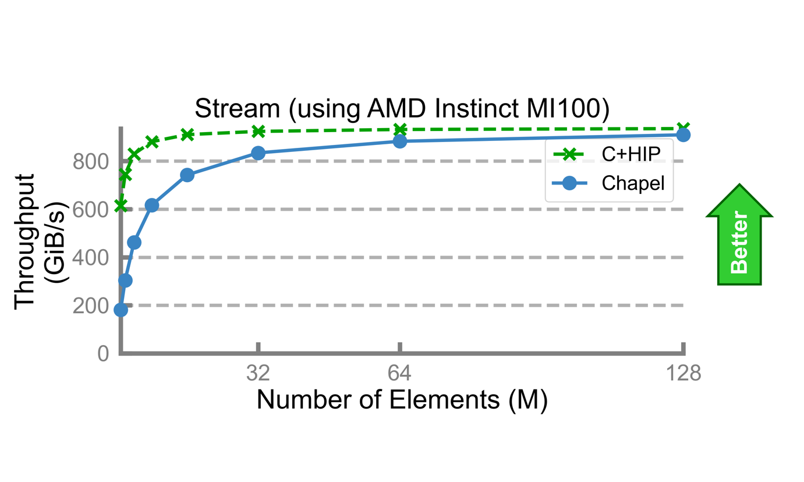
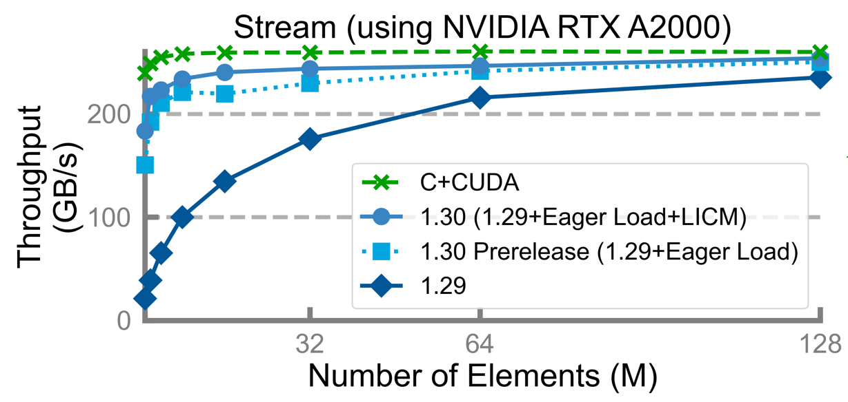
Stream Triad: Performance vs. Reference versions
Performance vs. reference versions has become increasingly competitive over the past 4 months

Slide 36
Other Chapel Examples
Primers
https://chapel-lang.org/docs/primers/index.html
Blog posts for Advent of Code
https://chapel-lang.org/blog/index.html
Test directory in main repository
https://github.com/chapel-lang/chapel/tree/main/test

Slide 37
Tutorial Summary
Takeaways
Chapel is a general-purpose programming language designed to leverage parallelism
It is being used in some large production codes
Our team is responsive to user questions and would enjoy having you participate in our community
How to get more help
Ask us questions on discourse, gitter, or stack overflow
Also feel free to email me at michelle.strout@hpe.com
Engaging with the community
Share your sample codes with us and your research community!
Join us at our free, virtual workshop in June, https://chapel-lang.org/CHIUW.html

Slide 38
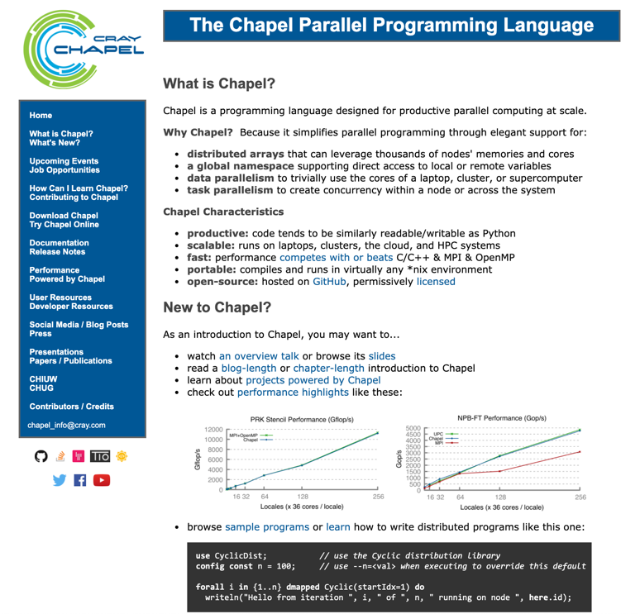
Chapel Resources
Chapel homepage: https://chapel-lang.org
(points to all other resources)
Social Media:
Twitter: @ChapelLanguage
Facebook: @ChapelLanguage
YouTube: http://www.youtube.com/c/ChapelParallelProgrammingLanguage
Community Discussion / Support:
Discourse: https://chapel.discourse.group/
Gitter: https://gitter.im/chapel-lang/chapel
Stack Overflow: https://stackoverflow.com/questions/tagged/chapel
GitHub Issues: https://github.com/chapel-lang/chapel/issues

